Slide 1


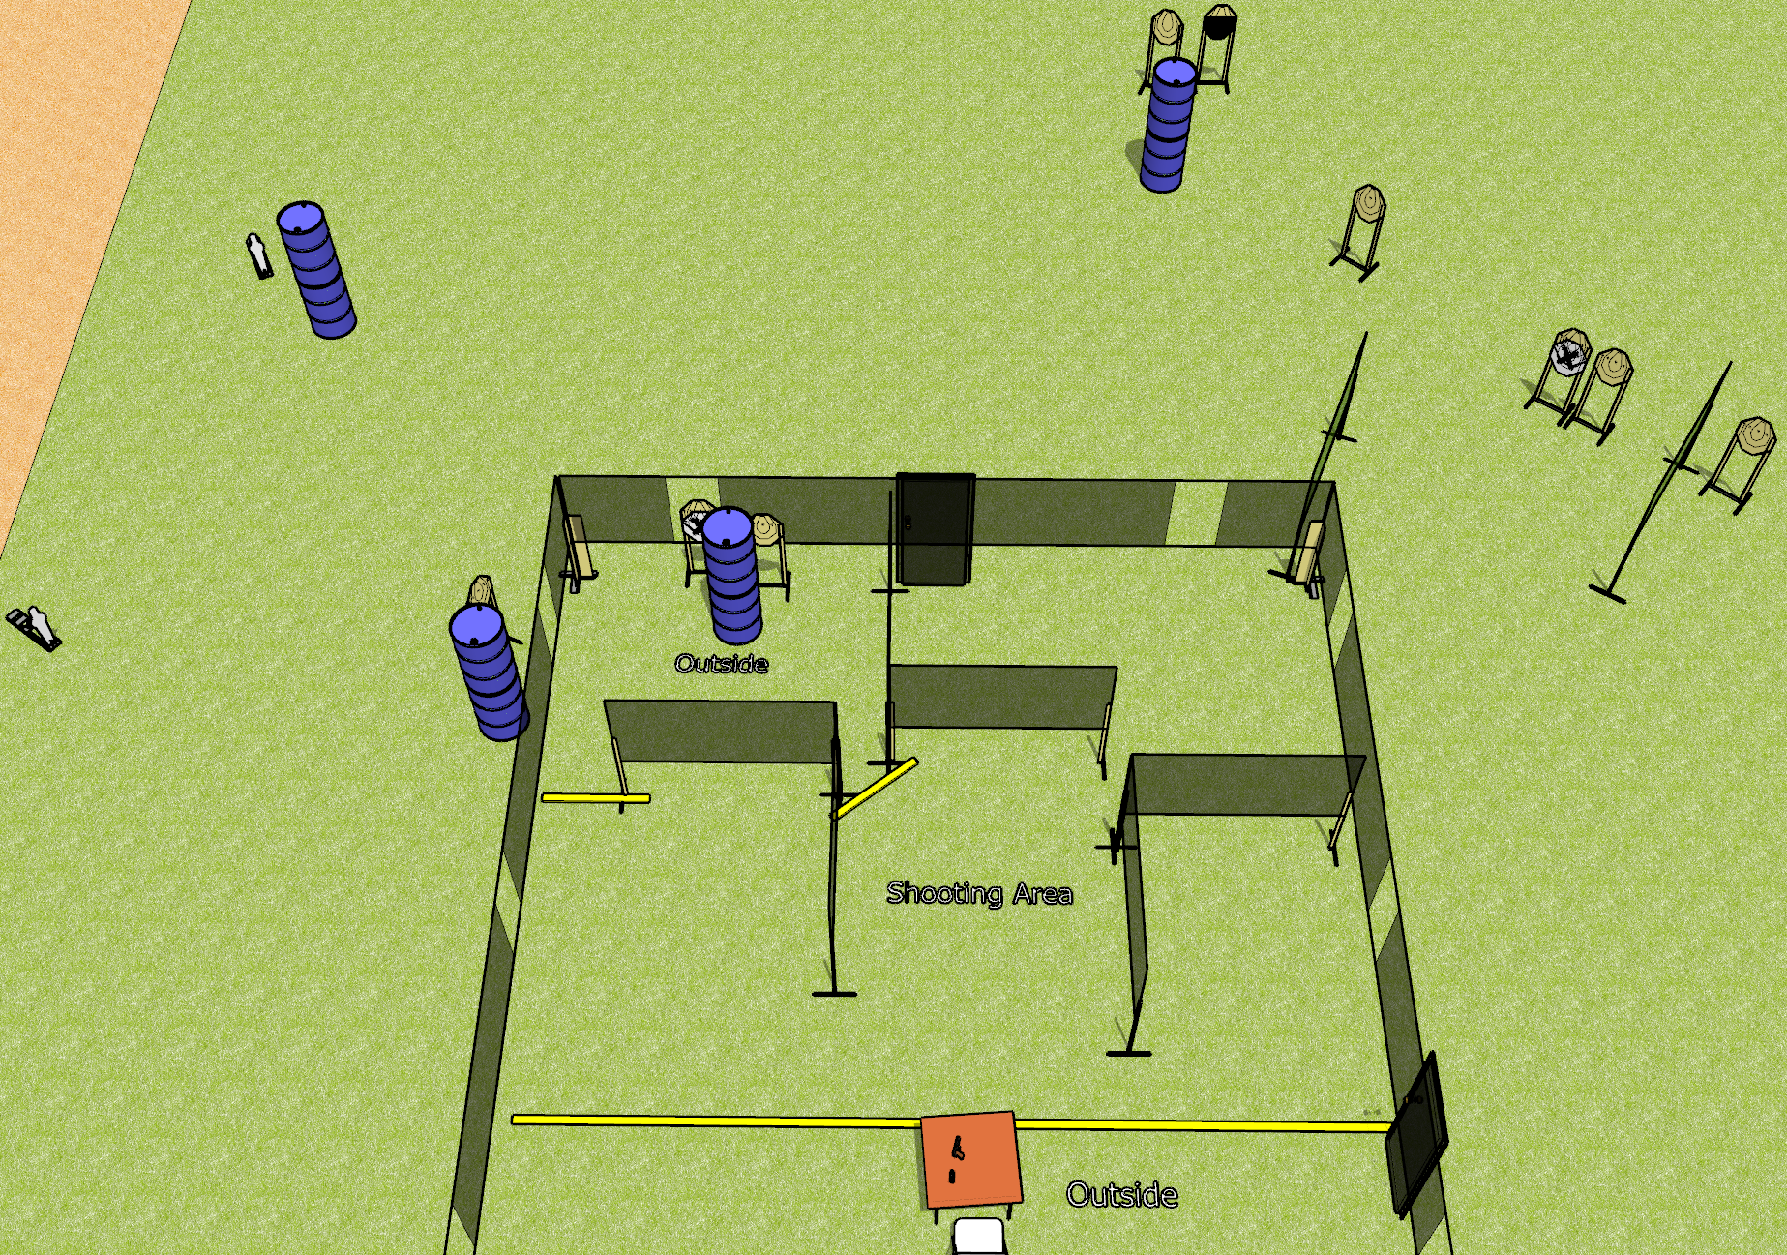
 | Dothan Gun Club – USPSA Match Take a Load Off Course Designer : Drew Coleman
Round Count 29 rounds 9 IPSC 2 mini poppers
Equipment List 4 wall feet 2 small fault lines Table + chair

Slide 2
Take a Load Off
Written Stage Briefing
Take a Load Off is a 29 round, 145 point, Comstock course of fire. There are 9 IPSC targets and 2 mini poppers. The best 3 hits on paper will score, and steel must fall to score. The start signal is audible.
Front door must be shut prior to start signal. See diagram or Drew/Patrick/Dan if there is confusion on what defines the shooting area.
Start position is seated in chair, back against back of chair, hands on knees. Firearm is on table, trigger guard on either mark, first magazine to be used on stage on other mark.
On start signal, engage targets as they become available from within the shooting area.

